Slide 1
Economic Development
Michelle Doherty, P.Eng, MPLAN
Community Member & Mother of a Kindergartener at Burton Elementary

Slide 2
According to Policy 409
6.4.2 DEC must consider a number of criteria including:
  Economic development: consideration of planned and future economic development projects in the community or surrounding area.
In addition to physical projects (which create jobs), economic development may also be viewed as any efforts that seek to improve the economic well-being and quality of life for a community by supporting or growing incomes and the tax base.

Slide 3
Burton, New Brunswick
Population ~2,400
Characterized as rural residential
The Major Employer for Burton residents is the 5th Canadian Division Support Base (5 CDSB) Gagetown
Within the limits of Burton businesses and / or Services include: Burton Elementary School; Burton Lions Club; Rob’s Autobody; Burton Courthouse (Service New Brunswick, Crown Prosecutor’s Regional Office, and Court Services); Burton Ultramar; Gilbert Farm Ltd; Pine Grove United Church & cemetery; and several home-based businesses.

Slide 4
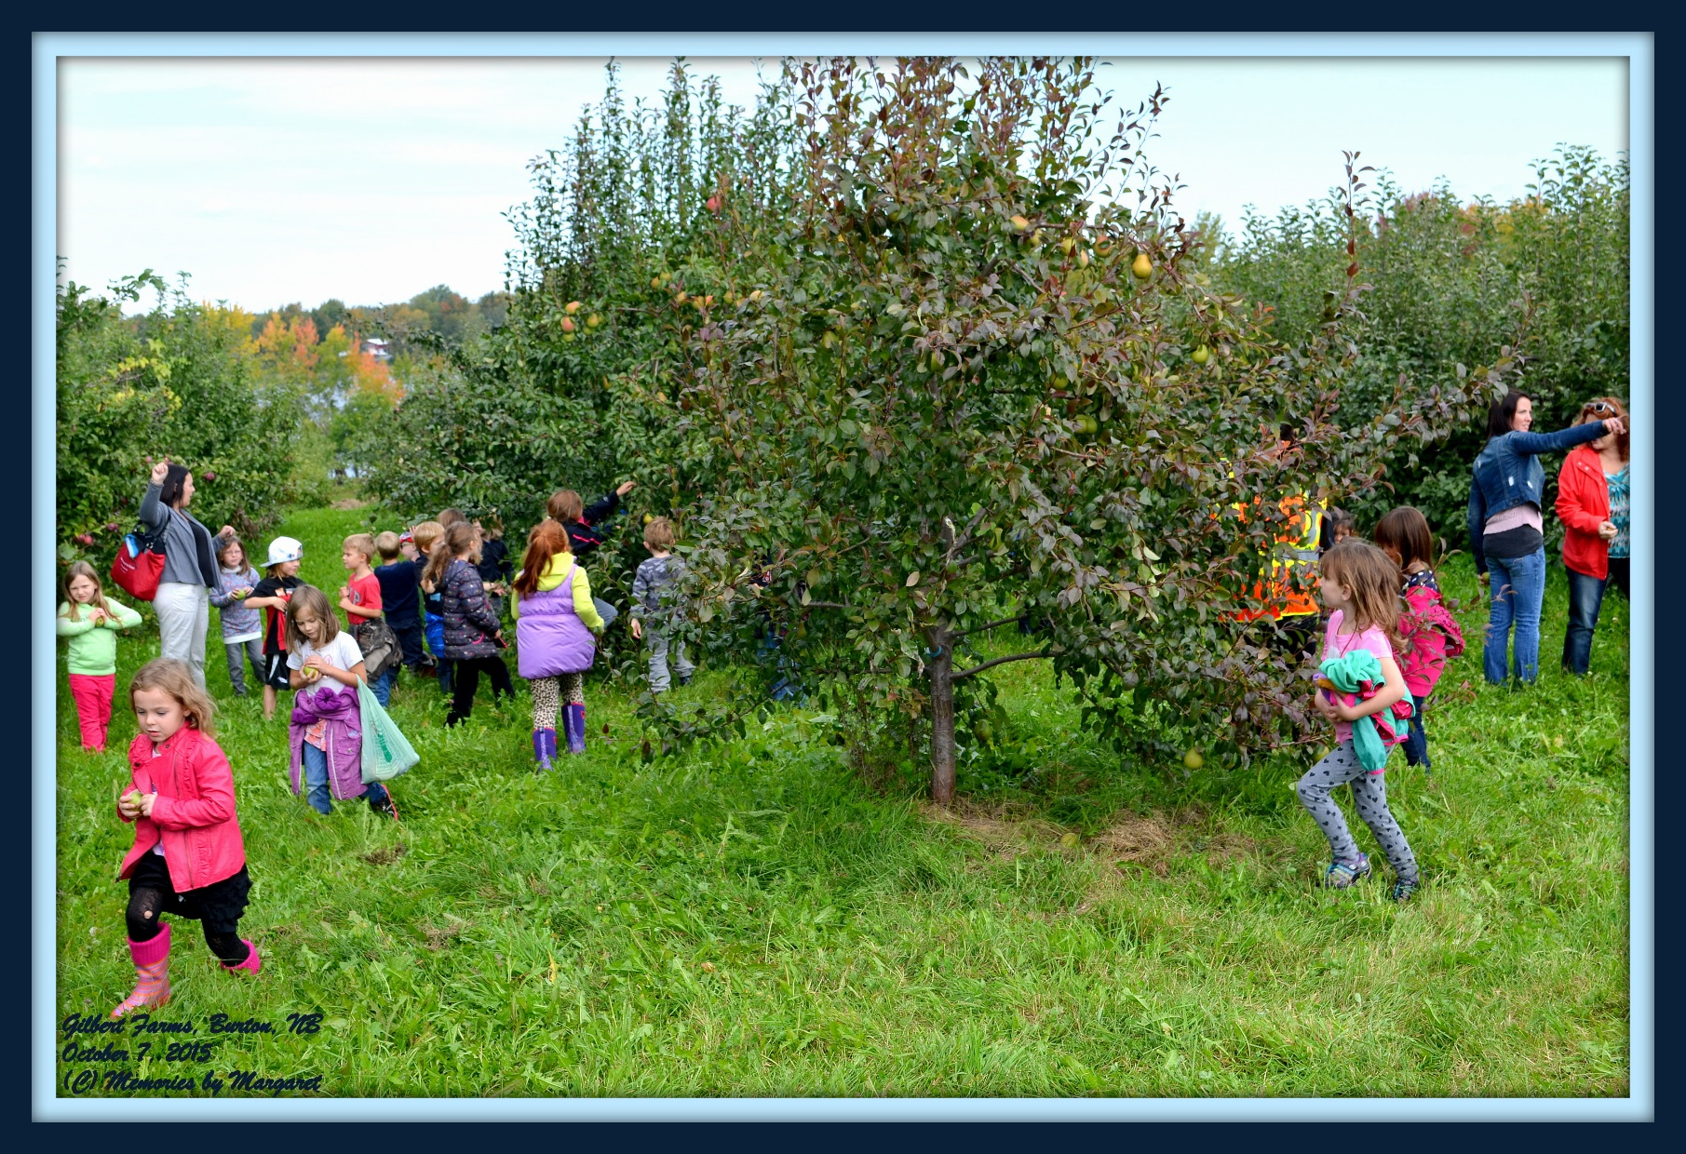
Burton School children apple picking at Gilbert Farms

Slide 5
Real Estate - Burton
Future Economic Development projects = housing developments
Burton-Geary Local Service District – one of highest tax bases in New Brunswick and continues to grow
Currently median house price in Burton = $224,900 (October 2015)…compare: Lincoln ($224,900) Geary ($138,500) New Maryland ($206,950);
Housing prices are considered by Canadian Real Estate Wealth Magazine to be high priced compared to the rest of New Brunswick (Home prices are 75th most expensive in the Province; out of 431)

Slide 6
Notes:
.

Slide 8
Listings vs. Sales

Slide 9
The Market
Characteristics of people buying or building in Burton:
  Young, middle class families with children;
  Generally one or both parents employed by the military;
  the existence of the Burton Elementary is one of the key factors in families decisions to locate here (anecdotal evidence).

Slide 10
Local Economic Benefits
A young, well-employed population = disposable income (a good portion likely spent in nearby Oromocto);
Burton Averages 11 housing starts per year (versus 7 average for Geary). Economic benefits per new home:
  Increase in the tax base (each new home = approximately $2,000 in property tax per annum);
  New homes (and renovations) in Burton generally constructed by local contractors (R. Maillet & Sons, Rocan Construction, Merle Smith & Sons Ltd., Herb Parent, etc.). New homes increase income to local residents;
  For new homes (and renovations) - building materials and equipment generally sourced from Oromocto and surrounding area suppliers (Roblynn Home Hardware, Canadian Tire, etc.), contributing further to the local economy.

Slide 11
Possible Economic Losses
If Burton Elementary is closed, negative economic impacts within the community may include:
  declining growth rate (loss in potential tax base);
  Removal of one of the few employers/services available within the Burton;
  Incoming military families may choose other communities where new schools have recently been built (Lincoln/Geary) or other places outside Oromocto such as New Maryland:
  Military families who choose areas such as Lincoln, New Maryland or anywhere in between, will likely spend the bulk of their disposable income in Fredericton as opposed to Oromocto.
  New housing starts in Lincoln, New Maryland, or other areas west/northwest of Oromocto will likely source material, equipment and contractors from Fredericton (= economic loss for Oromocto).

Slide 12
From an Economic Development standpoint, this could lead to:
What If?....Burton Elementary remained open with upgrades?
Increased Residential Growth = increased housing starts, increased tax base; increased income to local contractors and local Oromocto suppliers;
increased in general or home based businesses such as day cares, to service the growing community = increased local income;
Increased recreational developments (ball fields, playgrounds, recreational clubs, etc.);
Increased Community and other Groups;

Slide 13
Thank You /
Merci

